Slide 1
The Andy Warhol Machine
A COSC 519 Final Project

Slide 2
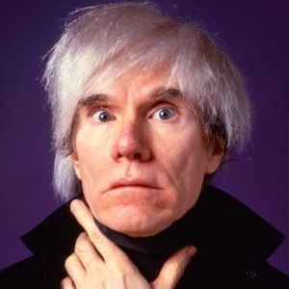
Introduction
Team Members
Steven Kennedy
Camden Thatcher
Andy Warhol
Notes:
Good Evening, my name is ______, this is ______ and that is Andy Warhol. Our project is The Andy Warhol Machine.

Slide 3
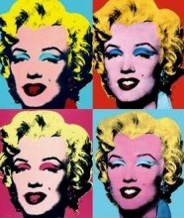
Project goals
Distributed Processing
Raspberry Pi Beowulf Cluster
Image Processing
Can we reproduce an iconic art style?
Notes:
We knew we wanted to do something with multi/distributed processing and also with Raspberry Pis. So, we came up with the idea of using a cluster of Pis, more the merrier. However, what are we going to have it do? In steps Andy Warhol. How about we have the cluster do image processing and try to reproduce Andy Warhol’s iconic pop art style (reference Monroe image)? Sold!

Slide 4
Technical Specifications
Laptop
Network Switch
Raspberry Pi 3
1.2GHz 64-bit Quad Core ARM CPU
1 Gb RAM
Python v2.7
Message Passing Interface (MPI)
Python Image Library (PIL)
Cluster Picture here?
Notes:
This is what we used to complete the project. The laptop and our cluster, which consists of four raspberry pis, are connected via a network switch which enables communication via message passing. We created a python script to handle the message passing and image processing; utilizing two python modules, MPI and PIL.

Slide 5
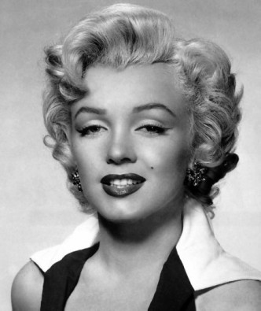
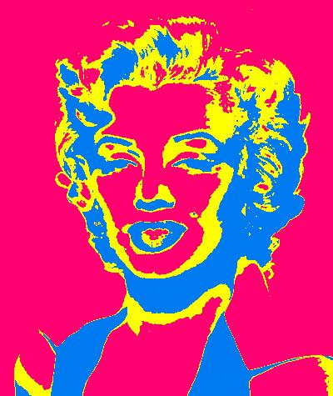
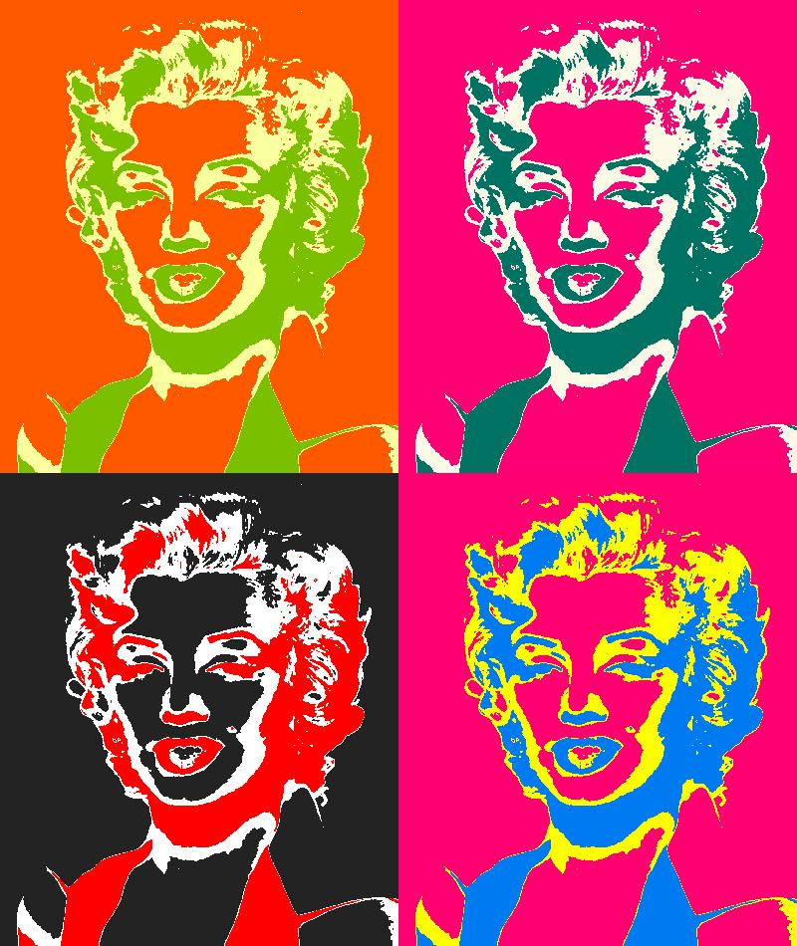
How it works
Notes:
How does this work?
(Show IMG1) The master node sends a message to each of the four pis, containing the image to process (resize width, colors)
Once a node receives the image it converts it to grayscale, and reads the image one pixel at a time.
It then, compares the pixels RGB value to a lower and upper bound, which we defined and tweaked to give an aesthetic look, and recolored the pixel where it fell within the bounds.
Doing this allowed us to play with a three color palette, producing an image that looks like this. (Show IMG 2)
The image is then resized and sent back to the master. Once the master receives all images it combines them into the final result (Show IMG 3)
Extra:
Images that work the best are simple, have a high contrast between boundaries
Tried adding more boundaries, but the images looked too busy with all the colors, 3-4 seemed to work the best
(Add some stuff on processing time, etc)

Slide 6
DEMO
We’ll do it live!

